Slide 1
TASK - 2
FINDING VULNERABILITY OF THE GIVEN WEBSITE USING NETSPARKER TOOL
Kanthimathi.C

Slide 2
Problem Statement :
Website Link: http://zero.webappsecurity.com/
We have set up a real life-like web application in the form of an online bank portal. Your task is to test this website and find all possible vulnerabilities and loopholes in it. To do so you can use the automatic vulnerabilities scanner “Netsparker” which was taught to you in the session of Automatic Vulnerability Scanner.
You have to find 3 critical vulnerabilities. No matter if they are taught to you or not. Now just choose any 1 amongst that 3 and write a report in your own language. If you are using Netsparker you can use the report already generated by software but make sure you do not have to copy it. You have to then submit the report generated by you.

Slide 3
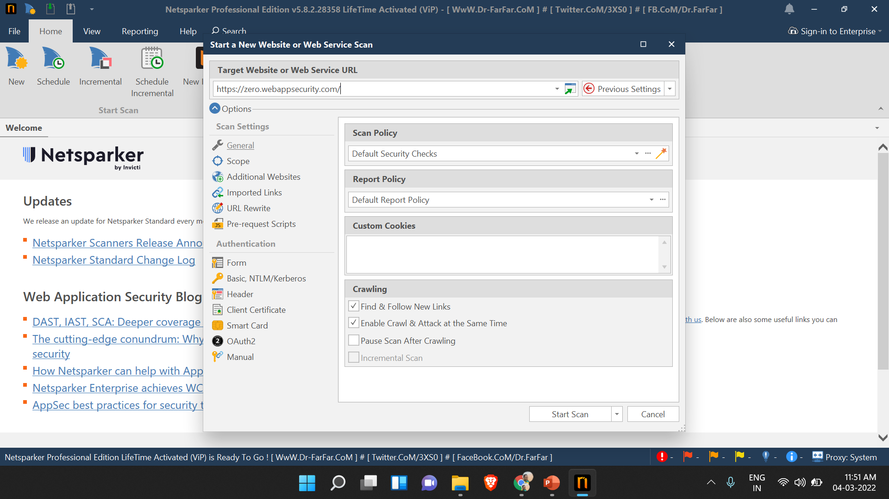

Slide 4
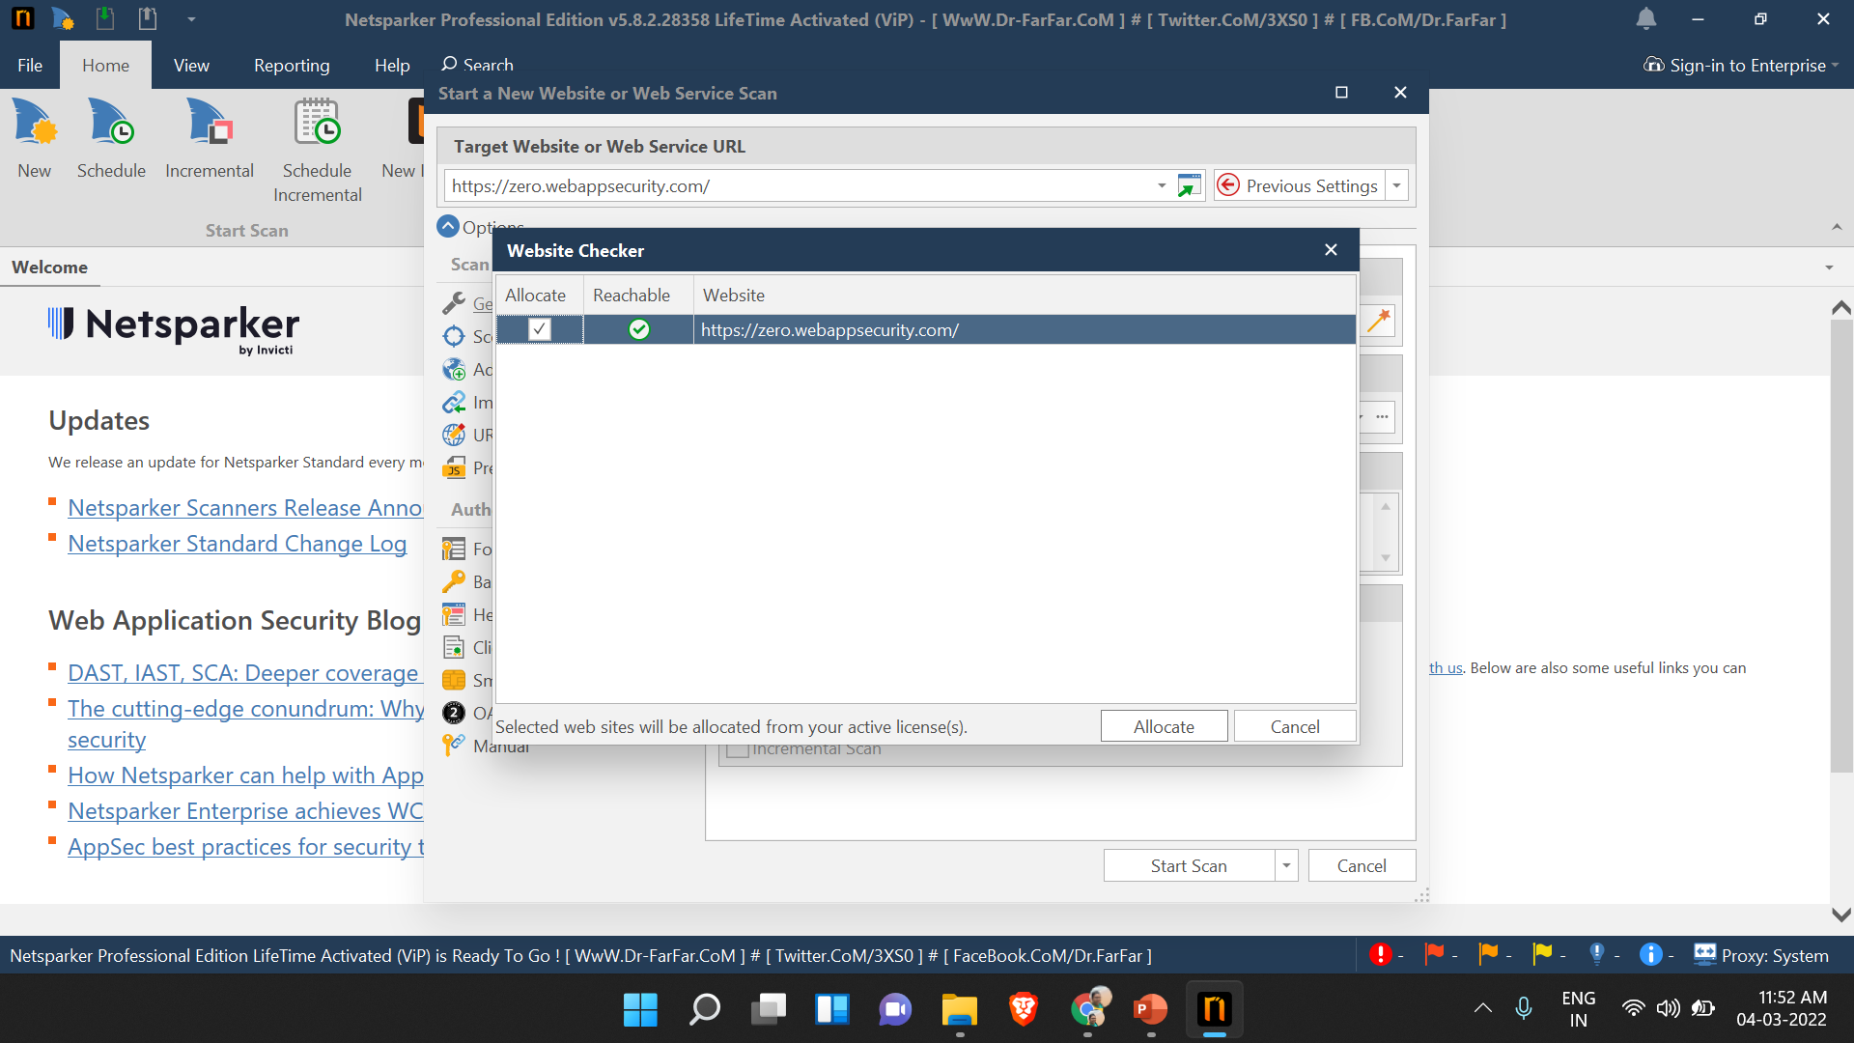

Slide 5
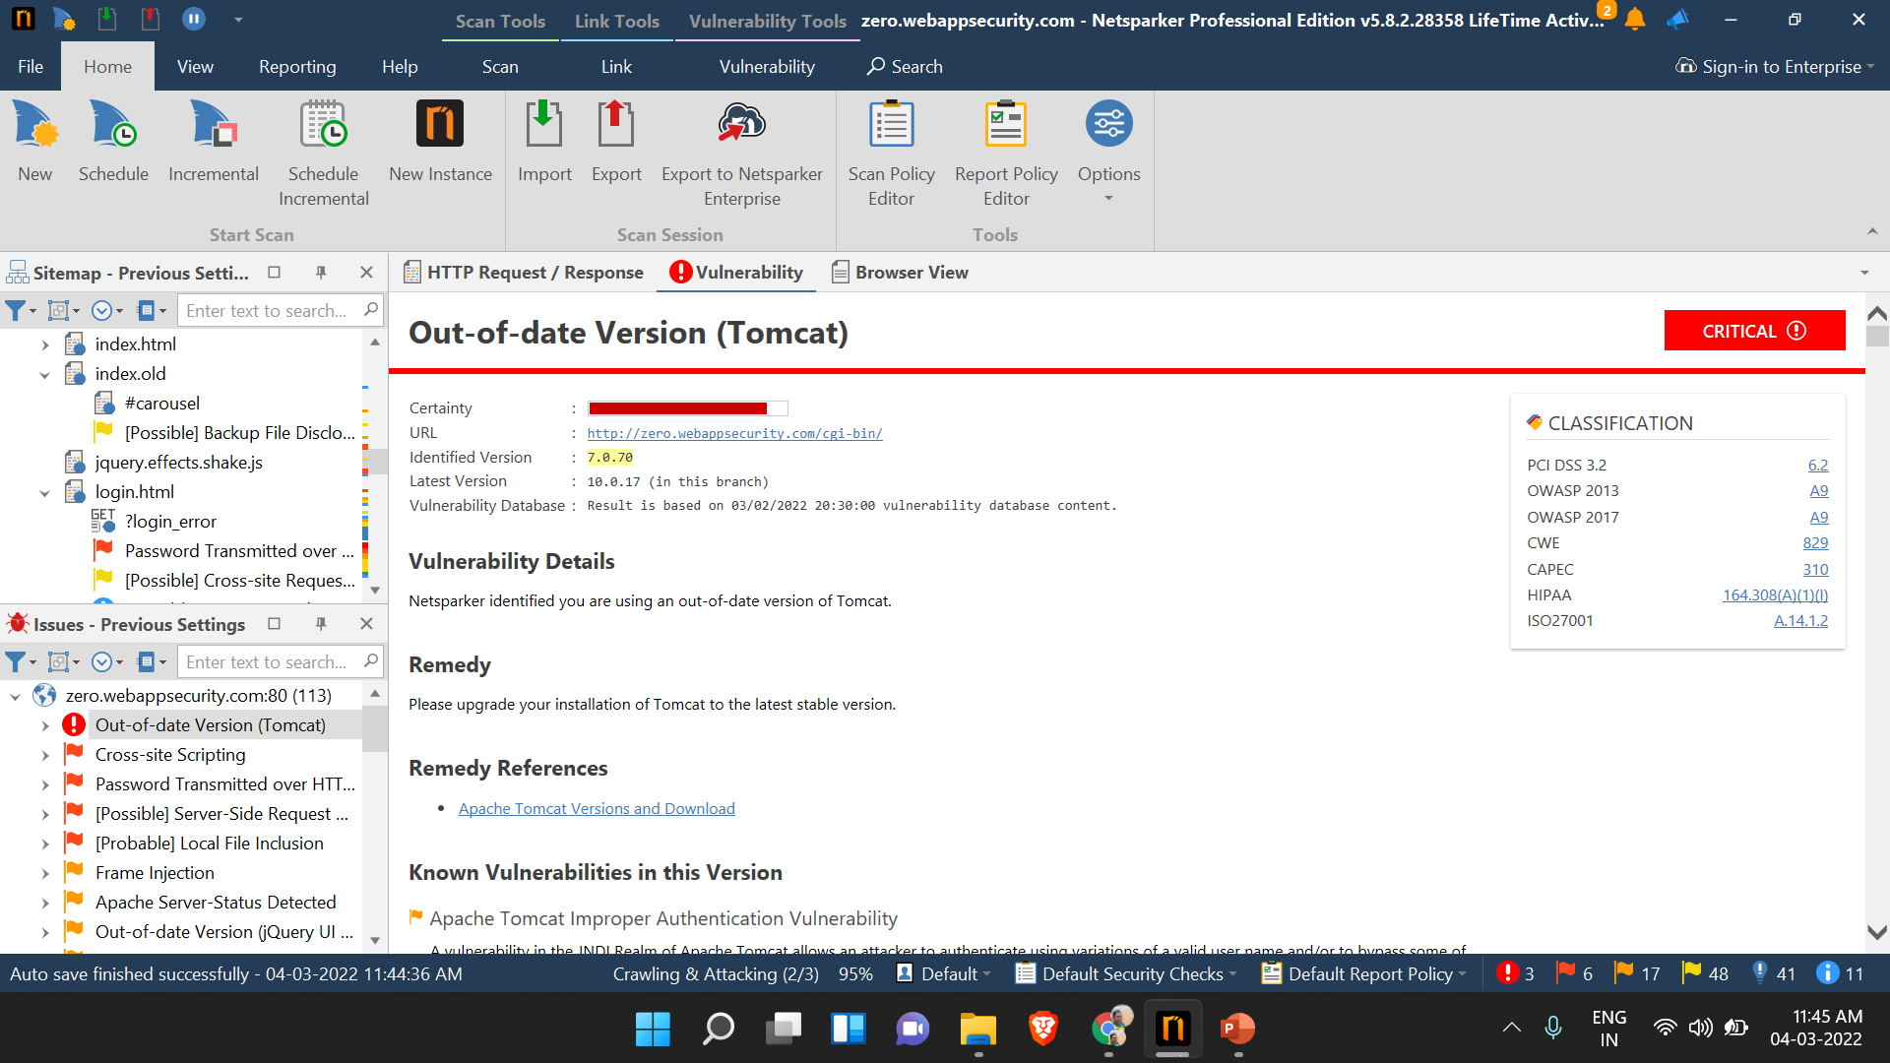

Slide 6
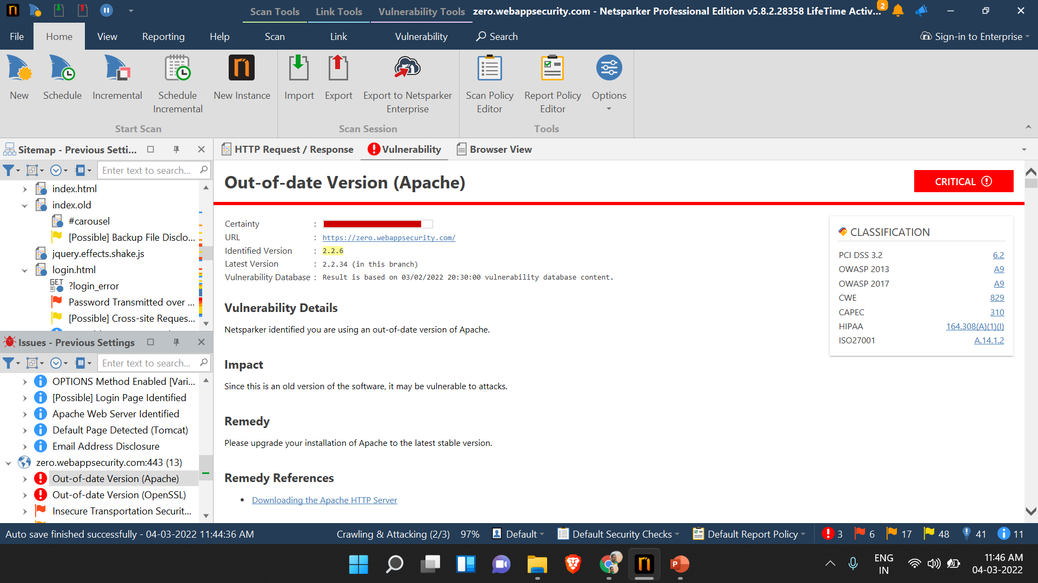

Slide 7


Slide 8
REPORT
TITLE: Out-of-date Version (Tomcat)
DOMAIN: http://zero.webappsecurity.com/
TOOL USED: Netsparker (Automatic Vulnerability Scanner)
VULNERABILITY TYPE: Critical
IDENTIFIED VERSION: 7.0.70
LATEST VERSION: 10.0.17(In this branch)
VULNERABILITY DETAILS:
Netsparker identified you are using an out-of-date version of Tomcat.

Slide 9
SOLUTION:
Please upgrade your installation of Tomcat to the latest stable version.
KNOWN VULNERABILITIES IN THIS VERSION:
Apache Tomcat Improper Authentication Vulnerability. A vulnerability in the JNDI Realm of Apache Tomcat allows an attacker to authenticate using variations of a valid user name and/or to bypass some of the protection provided by the LockOut Realm. This issue affects Apache Tomcat 10.0.0-M1 to 10.0.5; 9.0.0.M1 to 9.0.45; 8.5.0 to 8.5.65.
AFFECTED VERSIONS: 7.0.0 to 7.0.108

